Slide 1
OKR Cheat Sheet
Copyright © 2022 Accenture. All rights reserved.

Slide 2
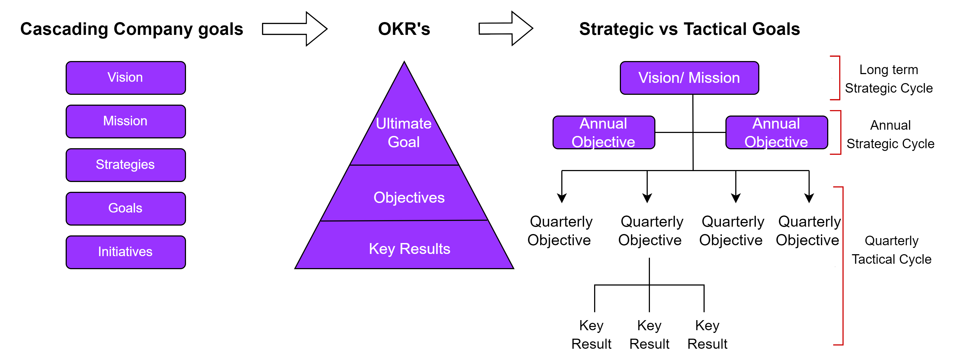
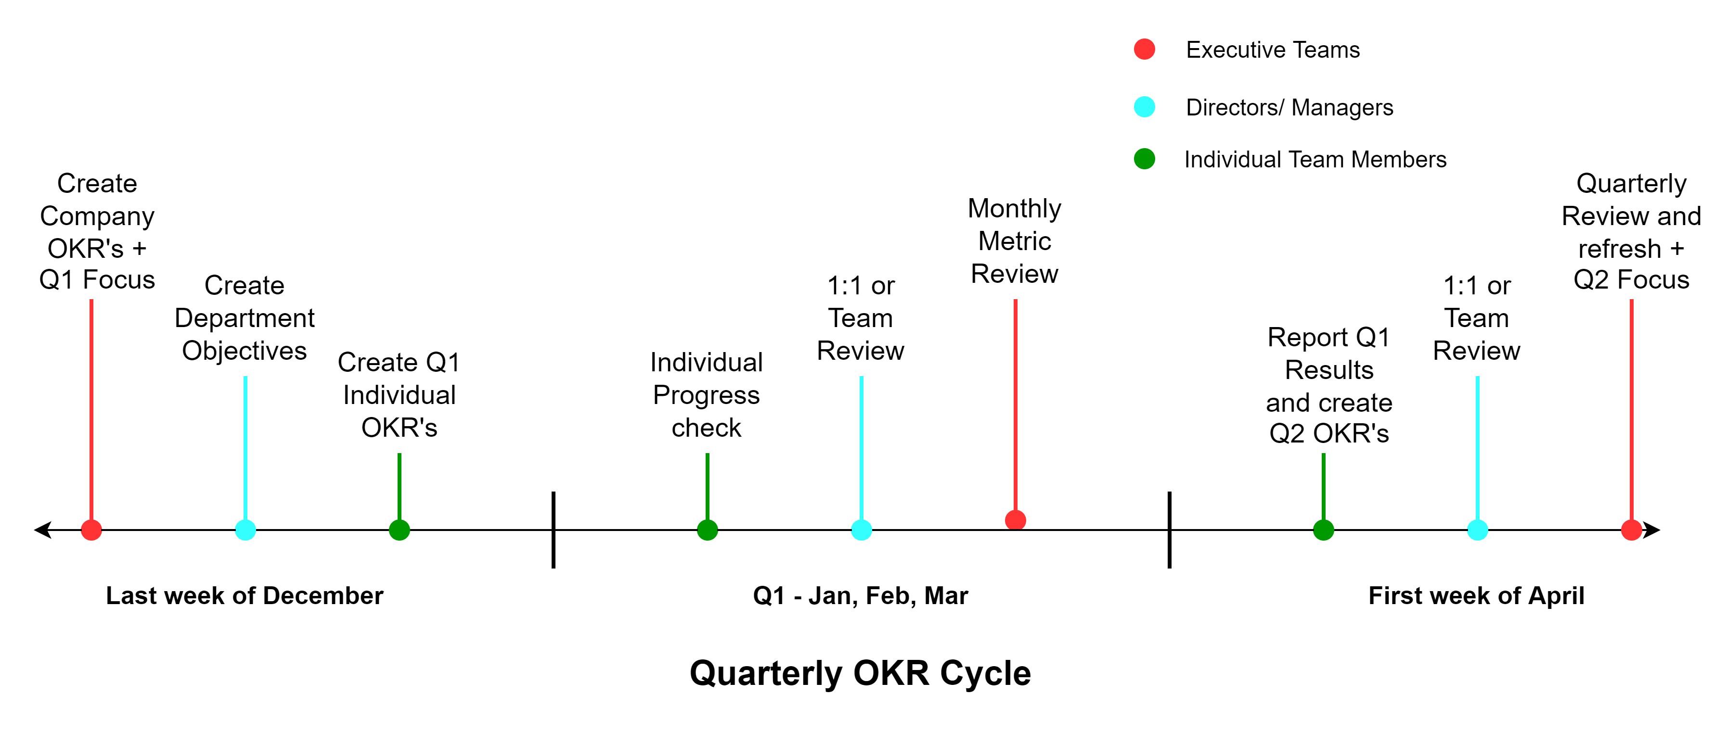
OKR – Objectives and Key Results
OKR is a lightweight management tool for setting company goals, aligning everyone towards the same priorities while pursuing (individual), team and company goals.
Objectives: Organization-wide goals with tangible, unambiguous outcomes and successful achievement must provide clear value for the Organization
Key Results: Inputs or deliverables to achieve the Objectives
OKR tips
Inspire, align and empower
No more than 3-5 areas of focus per team and per person and ask members of teams to set their key results to support any objective
KPI‘s are key metrics to deliver against our revenue/ Profitability targets and should be someone‘s Key Results
OKR‘s give Organization and team Alignment, Clear Direction, Increased Productivity, Trackable results and Insights for everyone
Example:
Objective: Grow our corporate global business
Key Results:
Hit company global sales target of $100 Million in Sales
Reduce churn to less than 5% annually (via Customer Success)
Increase the company average deal size by 30% (with upsells)

